Slide 1
Deploying AI, ML, and Chatbot Models in Edge and Cloud for Smart Manufacturing
Session16
Aakash Goel (made changes) on top of Prof. Arun slides

Slide 2
Deployment Strategies – Edge vs. Cloud
Edge AI (On-Premise, Near-Machine AI):
Benefits: Ultra-low latency, security, reduced cloud dependency
Tools: TensorFlow Lite, ONNX, NVIDIA Jetson, OpenVINO
Cloud AI (Centralized, Scalable AI):
Benefits: High computational power, predictive maintenance
Tools: AWS SageMaker, Azure ML, Google Vertex AI, Hugging Face
Notes:
"As we consider deploying AI and ML models, we have two primary strategies: Edge AI and Cloud AI. Each has its unique advantages and is suited to different scenarios within smart manufacturing.
Edge AI involves deploying models on-premise, close to the machines. This approach offers ultra-low latency, which is critical for real-time decision-making and control. It also enhances security by keeping data local and reduces dependency on cloud services. Tools like TensorFlow Lite, ONNX, NVIDIA Jetson, and OpenVINO are popular for implementing Edge AI solutions.
On the other hand, Cloud AI provides centralized, scalable AI capabilities. It leverages high computational power, making it ideal for tasks that require significant processing, such as predictive maintenance. Cloud platforms like AWS SageMaker, Azure ML, Google Vertex AI, and Hugging Face offer robust environments for developing and deploying AI models.
Understanding these deployment strategies helps us choose the right approach based on the specific needs and constraints of our manufacturing processes."

Slide 3
Chatbot Deployment in Manufacturing
Use Cases:
Real-time operator assistance, supply chain management
Predictive maintenance alerts, safety compliance
Open-Source Chatbot Tools: Rasa, BotPress
Paid Solutions: Google Dialogflow, IBM Watson Assistant, OpenAI API
Notes:
"Chatbots are becoming an integral part of smart manufacturing, offering a range of applications that streamline processes and improve productivity.
Use Cases: In manufacturing, chatbots can provide real-time operator assistance, helping workers troubleshoot issues or access information quickly. They also play a vital role in supply chain management by facilitating communication and coordination across different stages of production. Additionally, chatbots can deliver predictive maintenance alerts, ensuring equipment is serviced before failures occur, and assist in maintaining safety compliance by providing timely reminders and updates.
Open-Source Chatbot Tools: For those looking to implement chatbots with flexibility and customization, open-source tools like Rasa and BotPress offer powerful frameworks to build tailored solutions.
Paid Solutions: Alternatively, there are robust paid solutions available, such as Google Dialogflow, IBM Watson Assistant, and the OpenAI API, which provide advanced features and integrations to enhance chatbot capabilities.
By leveraging these tools, manufacturers can deploy chatbots that not only improve operational efficiency but also enhance the overall safety and reliability of manufacturing processes."

Slide 4
Vendor Selection Criteria & Discussion Points
🔹 Key Criteria:
Technical expertise and product maturity
Scalability & flexibility for future needs
Compliance with security & regulatory standards
Pricing models and long-term viability
🔹 Vendor Discussion Points:
Support & SLA agreements
Integration with existing manufacturing infrastructure
Deployment timeframes & ROI expectations
Notes:
"When it comes to selecting vendors for deploying AI, ML, and chatbot solutions in manufacturing, there are several key criteria and discussion points to consider:
Key Criteria:
Technical Expertise and Product Maturity: Ensure the vendor has a proven track record and mature products that meet your technical requirements.
Scalability & Flexibility for Future Needs: The solution should be able to grow and adapt as your manufacturing needs evolve.
Compliance with Security & Regulatory Standards: It's essential that the vendor adheres to industry security standards and regulatory requirements to protect your data and operations.
Pricing Models and Long-term Viability: Evaluate the cost-effectiveness of the vendor's pricing models and their ability to support your operations in the long term.
Vendor Discussion Points:
Support & SLA Agreements: Discuss the level of support provided and ensure that service level agreements (SLAs) align with your operational needs.
Integration with Existing Manufacturing Infrastructure: The solution should seamlessly integrate with your current systems to avoid disruptions.
Deployment Timeframes & ROI Expectations: Clarify the expected timelines for deployment and the anticipated return on investment to ensure alignment with your business goals.
By carefully evaluating these criteria and discussion points, you can select a vendor that not only meets your current needs but also supports your strategic objectives in smart manufacturing."

Slide 5
Infrastructure, Tools, and Technologies
💡 Infrastructure Planning:
Cloud vs. Edge deployment trade-offs
Network bandwidth & data latency considerations
AI model retraining & optimization strategies
🔧 Tools & Technologies:
AI/ML: TensorFlow, PyTorch, Hugging Face, ONNX
Data Storage: PostgreSQL, MySQL, AWS S3, Azure Blob Storage
Monitoring: MLflow, Prometheus, Grafana, AWS Model Monitor
Notes:
"Implementing AI and ML in smart manufacturing requires careful planning and the right set of tools and technologies. Let's break this down into two main areas: infrastructure planning and the tools and technologies available.
Infrastructure Planning:
Cloud vs. Edge Deployment Trade-offs: As we discussed earlier, choosing between cloud and edge deployment involves considering factors like latency, security, and computational needs. Each option has its trade-offs that must be evaluated based on your specific requirements.
Network Bandwidth & Data Latency Considerations: The infrastructure must support the necessary bandwidth and manage data latency to ensure real-time processing and decision-making.
AI Model Retraining & Optimization Strategies: Regular retraining and optimization of AI models are essential to maintain their accuracy and relevance as manufacturing processes and data evolve.
Tools & Technologies:
AI/ML Frameworks: Popular frameworks like TensorFlow, PyTorch, Hugging Face, and ONNX provide the foundation for developing and deploying AI models.
Data Storage Solutions: Reliable data storage is critical, with options like PostgreSQL, MySQL, AWS S3, and Azure Blob Storage offering scalable and secure environments.
Monitoring Tools: To ensure models perform as expected, tools like MLflow, Prometheus, Grafana, and AWS Model Monitor are used for monitoring and managing AI deployments.
By carefully planning your infrastructure and selecting the right tools, you can create a robust environment that supports the successful deployment and operation of AI and ML models in manufacturing."

Slide 6
Critical Clauses in Vendor Contracts
📜 Key Contractual Clauses:
Data ownership and security compliance
Service Level Agreements (SLAs) for uptime & performance
Exit strategy & migration flexibility
Liability clauses for failures & disruptions
✅ Recommended Best Practices:
Clearly define KPIs & expected outcomes
Negotiate favorable licensing terms
Consider hybrid vendor solutions for redundancy
Notes:
"When entering into agreements with vendors for AI and ML solutions, there are several key contractual clauses and best practices to consider:
Key Contractual Clauses:
Data Ownership and Security Compliance: Clearly define who owns the data and ensure compliance with relevant security standards to protect sensitive information.
Service Level Agreements (SLAs) for Uptime & Performance: Establish SLAs that guarantee the level of service and performance you require, minimizing downtime and disruptions.
Exit Strategy & Migration Flexibility: Include clauses that allow for a smooth transition if you decide to switch vendors or bring solutions in-house.
Liability Clauses for Failures & Disruptions: Define the vendor's liability in case of failures or disruptions to ensure accountability and recourse.
Recommended Best Practices:
Clearly Define KPIs & Expected Outcomes: Set clear key performance indicators (KPIs) and expected outcomes to measure the success of the deployment.
Negotiate Favorable Licensing Terms: Ensure that licensing terms are favorable and align with your usage and budgetary constraints.
Consider Hybrid Vendor Solutions for Redundancy: Explore hybrid solutions that involve multiple vendors to provide redundancy and mitigate risks.
By incorporating these clauses and practices into your vendor contracts, you can safeguard your investments and ensure that your AI and ML deployments are successful and sustainable."

Slide 7
Future Trends & Final Recommendations
🚀 Future Trends in Smart Manufacturing:
AI-driven automation & robotics advancements
Self-learning systems & federated AI
Increasing role of edge computing & decentralized AI
📌 Final Recommendations:
SMEs must continuously upskill in AI & data analytics
Select vendors based on scalability & security
Invest in real-time monitoring & performance optimization
Consider hybrid AI models combining edge & cloud computing
Notes:
"As we conclude our discussion on deploying AI, ML, and chatbot models in smart manufacturing, let's explore some future trends and final recommendations that can guide your strategic planning:
Future Trends in Smart Manufacturing:
AI-driven Automation & Robotics Advancements: The integration of AI with robotics is set to revolutionize manufacturing processes, enhancing precision, efficiency, and flexibility.
Self-learning Systems & Federated AI: These systems will enable more adaptive and personalized manufacturing processes, allowing for continuous improvement and innovation.
Increasing Role of Edge Computing & Decentralized AI: As we discussed earlier, edge computing will play a crucial role in reducing latency and enhancing data security, making it a key component of future manufacturing systems.
Final Recommendations:
SMEs Must Continuously Upskill in AI & Data Analytics: To stay competitive, small and medium-sized enterprises should invest in training and development to build expertise in AI and data analytics.
Select Vendors Based on Scalability & Security: As the landscape evolves, choosing vendors that offer scalable and secure solutions will be critical to long-term success.
Invest in Real-time Monitoring & Performance Optimization: Implementing robust monitoring systems will ensure that AI models perform optimally and deliver the desired outcomes.
Consider Hybrid AI Models Combining Edge & Cloud Computing: Leveraging both edge and cloud computing can provide the best of both worlds, offering flexibility, efficiency, and resilience.
By staying informed about these trends and following these recommendations, manufacturers can position themselves to capitalize on the opportunities presented by AI and ML technologies."

Slide 8
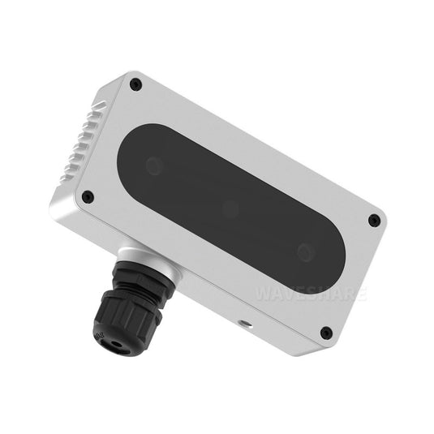
Devices for AI/ML Model Deployment in Manufacturing
NVIDIA (Jetson Series)
Edge AI computing platform for real-time ML inference.
Intel (Movidius VPU)
AI accelerator for deploying vision models on devices.
Siemens (SIMATIC Edge Devices)
For deploying ML models at the edge in industrial automation.
ABB (Ability™ Edge AI)
Smart robotics and edge computing for deploying AI models in manufacturing robots.
Rockwell Automation (Allen-Bradley Edge Gateway)
AI models for industrial IoT devices and operational systems.
HPE (Edgeline Series)
Edge devices optimized for running AI models in manufacturing environments.
Bosch Rexroth (CytroConnect Edge)
AI deployment for predictive maintenance and process optimization.
Fanuc (FIELD System)
Machine learning models deployed in factory automation systems.
Schneider Electric (EcoStruxure Machine Advisor)
ML models for predictive analytics and machine maintenance at the edge.
Dell Technologies (Edge Gateway Series)
AI/ML model deployment for real-time industrial data analytics.
Notes:
"Here, we have a list of key devices that are instrumental in deploying AI and ML models within manufacturing environments. These devices are designed to handle the unique demands of industrial settings:
NVIDIA (Jetson Series): Known for its edge AI computing platform, the Jetson series is ideal for real-time ML inference, providing the computational power needed for immediate decision-making.
Intel (Movidius VPU): This AI accelerator is tailored for deploying vision models on devices, making it suitable for applications that require image processing and analysis.
Siemens (SIMATIC Edge Devices): These devices are designed for deploying ML models at the edge, particularly in industrial automation, enhancing efficiency and control.
ABB (Ability™ Edge AI): Focused on smart robotics and edge computing, ABB's solutions are perfect for deploying AI models in manufacturing robots, improving precision and adaptability.
Rockwell Automation (Allen-Bradley Edge Gateway): This platform supports AI models for industrial IoT devices and operational systems, facilitating seamless integration and data flow.
HPE (Edgeline Series): Optimized for running AI models in manufacturing environments, these edge devices offer robust performance and reliability.
Bosch Rexroth (CytroConnect Edge): Specializing in AI deployment for predictive maintenance and process optimization, Bosch's solutions help prevent downtime and enhance productivity.
Fanuc (FIELD System): This system supports machine learning models deployed in factory automation systems, enabling smarter and more efficient operations.
Schneider Electric (EcoStruxure Machine Advisor): Designed for ML models in predictive analytics and machine maintenance at the edge, Schneider's solutions ensure proactive management and upkeep.
Dell Technologies (Edge Gateway Series): These devices facilitate AI/ML model deployment for real-time industrial data analytics, providing insights that drive informed decision-making.
By leveraging these devices, manufacturers can effectively deploy AI and ML models, enhancing their operations and staying competitive in the evolving landscape of smart manufacturing."

Slide 9
Challenges and Considerations in AI/ML Deployment
AI Survilence
Immature problem statement from the users
Network & Communication Protocols
Notes:
"Deploying AI and ML models in manufacturing environments comes with its own set of challenges. Let's discuss some of the key issues that need to be addressed:
AI Surveillance: As AI systems become more integrated into manufacturing processes, there is a growing need for surveillance to monitor their performance and ensure they operate as intended. This involves setting up robust monitoring systems to detect anomalies and maintain system integrity.
Immature Problem Statement from the Users: One common challenge is the lack of a well-defined problem statement from users. Without a clear understanding of the problem, it becomes difficult to design and deploy effective AI solutions. It's essential to work closely with stakeholders to refine problem statements and align AI capabilities with business needs.
Network & Communication Protocols: The deployment of AI models often requires reliable network infrastructure and communication protocols. Ensuring that these systems are robust and capable of handling the data flow is critical for real-time processing and decision-making. This includes addressing issues related to bandwidth, latency, and data security.
By proactively addressing these challenges, manufacturers can enhance the effectiveness of their AI and ML deployments, leading to improved efficiency and productivity."

Slide 10
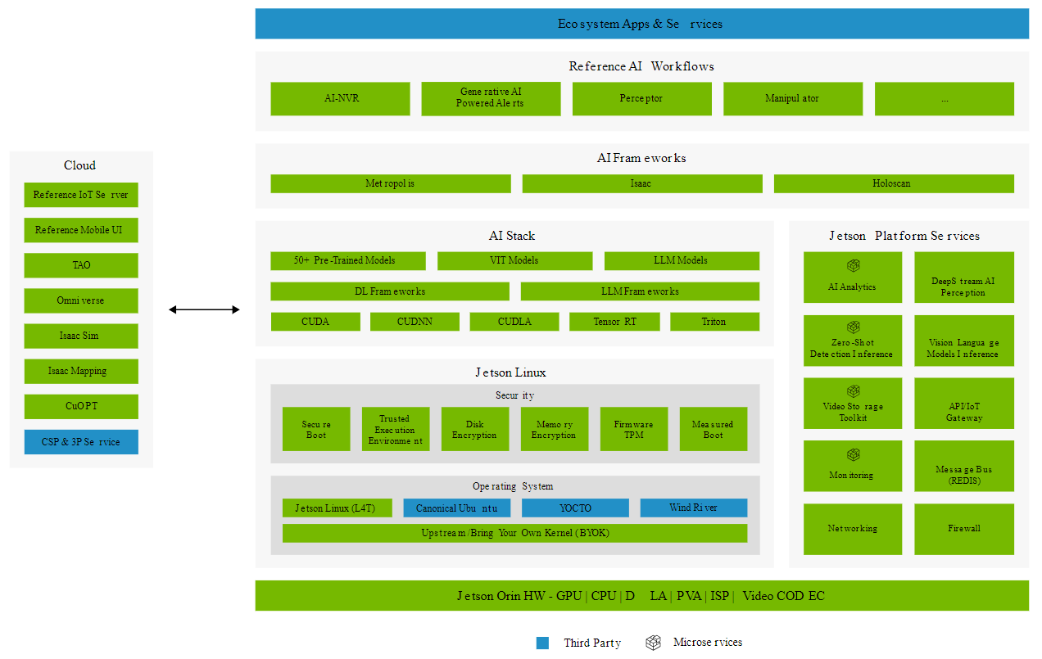
Notes:
"This slide provides an overview of the NVIDIA Jetson platform, which is a powerful solution for deploying AI and ML models at the edge. Let's break down the components and how they contribute to a robust AI ecosystem:
Cloud Integration: The platform supports integration with cloud services, including Reference IoT Server, Mobile UI, and tools like TAO and Omniverse. This allows for seamless data exchange and model updates between edge devices and cloud infrastructure.
Ecosystem Apps & Services: The platform offers a range of applications and services, such as AI-NVR for video analytics and generative AI-powered alerts. These services enable manufacturers to implement advanced AI workflows tailored to their specific needs.
AI Frameworks and Stack: The Jetson platform supports various AI frameworks, including Metropolis and Isaac, which facilitate the development and deployment of AI models. The AI stack includes pre-trained models, DL frameworks, and tools like CUDA and TensorRT, providing the computational power needed for complex AI tasks.
Jetson Linux and Security: The platform runs on Jetson Linux, offering a secure and customizable operating system environment. Security features like secure boot, disk encryption, and trusted execution environments ensure data integrity and protection.
Jetson Platform Services: A suite of services, including AI analytics, deepstream AI perception, and video storage toolkit, supports the deployment and management of AI models. These services help optimize performance and ensure reliable operation in manufacturing environments.
By leveraging the NVIDIA Jetson platform, manufacturers can overcome many of the challenges associated with AI deployment, achieving greater efficiency and innovation in their operations."

